Slide 1
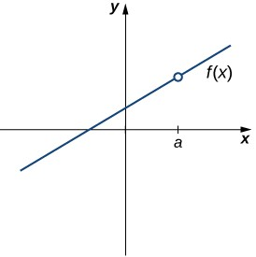
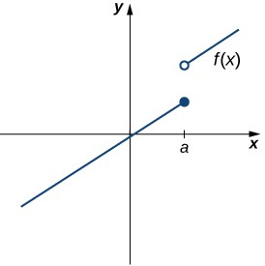
2.5: CONTINUITY
Many functions have the property that their graphs can be traced with a pencil without lifting the pencil from the page. Such functions are called continuous. Other functions have points at which a break in the graph occurs, but satisfy this property over intervals contained in their domains. They are continuous on these intervals and are said to have a discontinuity at a point where a break occurs.
We begin our investigation of continuity by exploring what it means for a function to have continuity at a point. Intuitively, a function is continuous at a particular point if there is no break in its graph at that point.
CONTINUITY AT A POINT
Before we look at a formal definition of what it means for a function to be continuous at a point, let’s consider various functions that fail to meet our intuitive notion of what it means to be continuous at a point. We then create a list of conditions that prevent such failures.
Our first function of interest is shown in Figure 2.5.1. We see that the graph of f(x) has a hole at a. In fact, f(a) is undefined. At the very least, for f(x) to be continuous at a, we need the following condition:
I. f(a) IS DEFINED
Figure 2.5.1: The function f(x) is not continuous at a because f(a) is undefined.
However, as we see in Figure 2.5.2, this condition alone is insufficient to guarantee continuity at the point a. Although f(a) is defined, the function has a gap at a. In this example, the gap exists because lim f(x) does not exist. We must add another
x→a
condition for continuity at a—namely,
II. lim f(x) EXISTS
x→a
Figure 2.5.2: The function f(x) is not continuous at a because lim f(x) does not exist.
x→a
However, as we see in Figure 2.5.3, these two conditions by themselves do not guarantee continuity at a point. The function in this figure satisfies both of our first two conditions, but is still not continuous at a. We must add a third condition to our list:
III. lim f(x) = f(a)
x→a

Slide 2
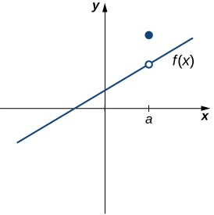
Figure 2.5.3: The function f(x) is not continuous at a because lim f(x) ≠ f(a).
x→a
Now we put our list of conditions together and form a definition of continuity at a point.
Definition: continuous at a point
A function f(x) is continuous at a point a if and only if the following three conditions are satisfied:
f(a) is defined
lim f(x) exists
x→a
lim f(x) = f(a)
x→a
A function is discontinuous at a point \(a\) if it fails to be continuous at a.
The following procedure can be used to analyze the continuity of a function at a point using this definition.
Problem-Solving Strategy: Determining Continuity at a Point
  Check to see if f(a) is defined. If f(a) is undefined, we need go no further. The function is not continuous at a. If f(a) is defined, continue to step 2.
  Compute lim f(x) . In some cases, we may need to do this by first computing lim f(x) and lim f(x) . If lim f(x)
x→a x→a⁻ x→a⁺ x→a
does not exist (that is, it is not a real number), then the function is not continuous at a and the problem is solved. If
lim f(x) exists, then continue to step 3.
x→a
  Compare f(a) and lim f(x) . If lim f(x) ≠ f(a) , then the function is not continuous at a. If lim f(x) = f(a) , then
x→a x→a x→a
the function is continuous at a.
The next three examples demonstrate how to apply this definition to determine whether a function is continuous at a given point. These examples illustrate situations in which each of the conditions for continuity in the definition succeed or fail.
Example 2.5.1A: Determining Continuity at a Point, Condition 1
Using the definition, determine whether the function f(x) =
Solution
x² − 4
is continuous at x = 2 . Justify the conclusion.
x − 2
Let’s begin by trying to calculate f(2) . We can see that f(2) = 0/0 , which is undefined. Therefore, f(x) =
discontinuous at 2 because f(2) is undefined. The graph of f(x) is shown in Figure 2.5.4.
x² − 4
is
x − 2

Slide 3
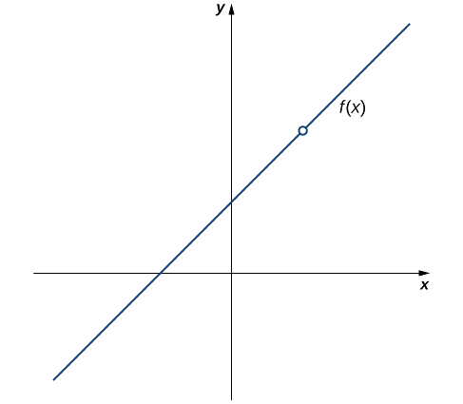
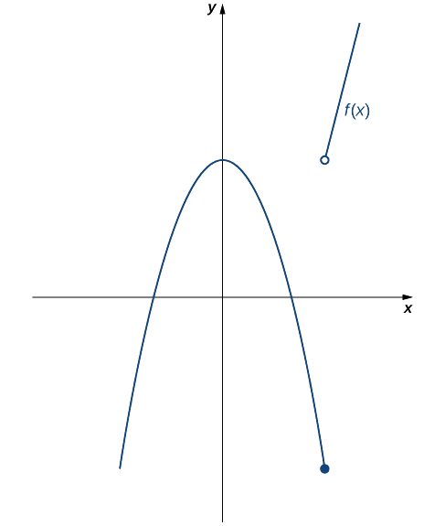
Figure 2.5.4: The function f(x) is discontinuous at 2 because f(2) is undefined.
Using the definition, determine whether the function f(x) = {
conclusion.
Solution
Let’s begin by trying to calculate f(3) .
Example 2.5.1B: Determining Continuity at a Point, Condition 2
2
−x + 4if x ≤ 3 4x − 8if x > 3
is continuous at x = 3 . Justify the
f(3) = −(3² ) + 4 = −5 .
Thus, f(3) is defined. Next, we calculate lim f(x). To do this, we must compute lim f(x) and lim f(x):
x→3 x→3⁻ x→3⁺
lim f(x) = −(3² ) + 4 = −5
x→3⁻
and
lim f(x) = 4(3) − 8 = 4 .
x→3⁺
Therefore, lim f(x) does not exist. Thus, f(x) is not continuous at 3. The graph of f(x) is shown in Figure 2.5.5.
x→3
Figure 2.5.5: The function f(x) is not continuous at 3 because lim f(x) does not exist.
x→3

Slide 4
Using the definition, determine whether the function f(x) = {
Example 2.5.1C : Determining Continuity at a Point, Condition 3
^{sinx} ifx ≠ 0
is continuous at x=0.
x
1ifx = 0
Solution
First, observe that
Next,
f(0) = 1
lim_{x→0} f(x) = lim_{x→0} ^{sinx} = 1 .
x
Last, compare f(0) and lim_{x→1} f(x). We see that
f(0) = 1 = lim_{x→0} f(x) .
Since all three of the conditions in the definition of continuity are satisfied, f(x) is continuous at x = 0 .
Exercise 2.5.1
⎧2x + 1ifx < 1
Using the definition, determine whether the function f(x) = ⎨
⎩
2ifx = 1
−x + 4ifx > 1
is continuous at x = 1 . If the function is
not continuous at 1, indicate the condition for continuity at a point that fails to hold.
Hint
Check each condition of the definition.
Answer
f is not continuous at 1 because f(1) = 2 ≠ 3 = lim_{x→1} f(x) .
By applying the definition of continuity and previously established theorems concerning the evaluation of limits, we can state the following theorem.
Continuity of Polynomials and Rational Functions
Polynomials and rational functions are continuous at every point in their domains.
Proof
Previously, we showed that if p(x) and q(x) are polynomials, lim_{x→a} p(x) = p(a) for every polynomial p(x) and
lim_{x→a q(x)} = _{q(a)} as long as q(a) ≠ 0 . Therefore, polynomials and rational functions are continuous on their domains.
□
p(x) p(a)
We now apply Note to determine the points at which a given rational function is continuous.
Example 2.5.2:Continuity of a Rational Function
For what values of x is f(x) = ^{x+1} continuous?
Solution
x−5
The rational function f(x) = ^{x+1} is continuous for every value of x except x = 5 .
x−5
Exercise 2.5.2
For what values of x is f(x) = 3x⁴ − 4x² continuous?
Hint
Use Note
Answer
f(x) is continuous at every real number.
TYPES OF DISCONTINUITIES
As we have seen in Example and Example, discontinuities take on several different appearances. We classify the types of discontinuities we have seen thus far as removable discontinuities, infinite discontinuities, or jump discontinuities. Intuitively, a removable discontinuity is a discontinuity for which there is a hole in the graph, a jump discontinuity is a noninfinite discontinuity for which the sections of the function do not meet up, and an infinite discontinuity is a discontinuity located at a

Slide 5
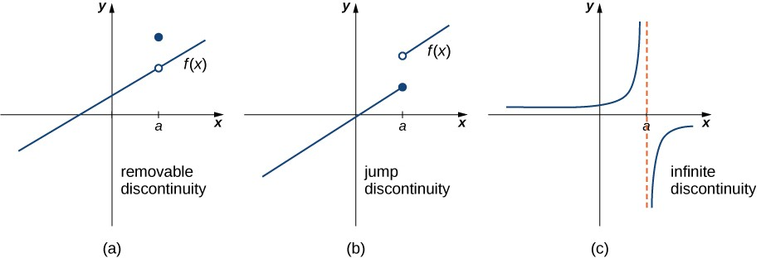
vertical asymptote. Figure 2.5.5 illustrates the differences in these types of discontinuities. Although these terms provide a handy way of describing three common types of discontinuities, keep in mind that not all discontinuities fit neatly into these categories.
Figure 2.5.5: Discontinuities are classified as (a) removable, (b) jump, or (c) infinite.
These three discontinuities are formally defined as follows:
Definition
If f(x) is discontinuous at a, then
f has a removable discontinuity at a if lim_{x→a} f(x) exists. (Note: When we state that lim_{x→a} f(x) exists, we mean that
lim_{x→a} f(x) = L , where L is a real number.)
f has a jump discontinuity at a if lim_{x→a}− f(x) and lim_{x→a}+ f(x) both exist, but lim_{x→a}− f(x) ≠ lim_{x→a}+ f(x) . (Note: When we state that lim_{x→a}− f(x) and lim_{x→a}+ f(x) both exist, we mean that both are real-valued and that neither take on the values ±∞.)
f has an infinite discontinuity at a if lim_{x→a}⁻ f(x) = ±∞ or lim_{x→a}⁺ f(x) = ±∞ .
Example 2.5.3: Classifying a Discontinuity
2
In Example, we showed that f(x) = ^{x −4} is discontinuous at x = 2 . Classify this discontinuity as removable, jump, or
infinite.
Solution
x−2
To classify the discontinuity at 2 we must evaluate lim_{x→2} f(x):
x² −4
lim f(x) = lim
=lim
x→2
(x−2)(x+2)
x→2 _{x−2}
x→2
x−2
=lim_{x→2} (x + 2)
=4.
Since f is discontinuous at 2 and lim_{x→2} f(x) exists, f has a removable discontinuity at x=2.
Example 2.5.4: Classifying a Discontinuity
In Example, we showed that f(x) = {
removable, jump, or infinite.
Solution
2
−x + 4ifx ≤ 3 4x − 8ifx > 3
is discontinuous at x = 3 . Classify this discontinuity as
Earlier, we showed that f is discontinuous at 3 because lim_{x→3} f(x) does not exist. However, since lim_{x→3}− f(x) = −5 and
lim_{x→3}− f(x) = 4 both exist, we conclude that the function has a jump discontinuity at 3.
Example 2.5.5: Classifying a Discontinuity
Determine whether f(x) = ^{x+2} is continuous at −1. If the function is discontinuous at −1, classify the discontinuity as
removable, jump, or infinite.
Solution
x+1
The function value f(−1) is undefined. Therefore, the function is not continuous at −1. To determine the type of
x+2 x+2
discontinuity, we must determine the limit at −1. We see that lim_{x→−1}⁻ _{x+1} = −∞ and lim_{x→−1}⁺ _{x+1} = +∞ . Therefore,
the function has an infinite discontinuity at −1.
Exercise 2.5.3

Slide 6
For f(x) = {
x² ifx ≠ 1 3ifx = 1
, decide whether f is continuous at 1. If f is not continuous at 1, classify the discontinuity as
removable, jump, or infinite.
Hint
Follow the steps in Note. If the function is discontinuous at 1, look at lim_{x→1} f(x)
Answer
Discontinuous at 1; removable
CONTINUITY OVER AN INTERVAL
Now that we have explored the concept of continuity at a point, we extend that idea to continuity over an interval. As we develop this idea for different types of intervals, it may be useful to keep in mind the intuitive idea that a function is continuous over an interval if we can use a pencil to trace the function between any two points in the interval without lifting the pencil from the paper. In preparation for defining continuity on an interval, we begin by looking at the definition of what it means for a function to be continuous from the right at a point and continuous from the left at a point.
Continuity from the Right and from the Left
A function f(x) is said to be continuous from the right at a if lim f(x) = f(a) .
x→a⁺
A function f(x) is said to be continuous from the left at a if lim f(x) = f(a)
x→a⁻
A function is continuous over an open interval if it is continuous at every point in the interval. A function f(x) is continuous over a closed interval of the form [a, b] if it is continuous at every point in (a, b) and is continuous from the right at a and is continuous from the left at b. Analogously, a function f(x) is continuous over an interval of the form (a, b] if it is continuous over (a, b) and is continuous from the left at b. Continuity over other types of intervals are defined in a similar fashion.
Requiring that lim f(x) = f(a) and lim f(x) = f(b) ensures that we can trace the graph of the function from the point
x→a⁺ x→b⁻
(a, f(a)) to the point (b, f(b)) without lifting the pencil. If, for example, lim f(x) ≠ f(a) , we would need to lift our pencil
x→a⁺
to jump from f(a) to the graph of the rest of the function over (a, b].
Example 2.5.6: Continuity on an Interval
State the interval(s) over which the function f(x) =
Solution
x−1
is continuous.
x² +2x
Since f(x) =
x−1
is a rational function, it is continuous at every point in its domain. The domain of f(x) is the set
x² +2x
(−∞, −2) ∪ (−2, 0) ∪ (0, +∞) . Thus, f(x) is continuous over each of the intervals (−∞, −2), (−2, 0) , and (0, +∞).
Example 2.5.7: Continuity over an Interval
State the interval(s) over which the function f(x) = √4 − x² is continuous.
Solution
From the limit laws, we know that lim_{x→a} √4 − x² = √4 − a² for all values of a in (−2, 2). We also know that
lim_{x→−2}⁺ √4 − x² = 0 exists and lim_{x→2}⁻ √4 − x² = 0 exists. Therefore, f(x) is continuous over the interval [−2, 2].
Exercise 2.5.4
State the interval(s) over which the function f(x) = √x + 3 is continuous.
Hint
Use Example as a guide for solving.
Answer
[−3,+∞)
The Note allows us to expand our ability to compute limits. In particular, this theorem ultimately allows us to demonstrate that trigonometric functions are continuous over their domains.
Composite Function Theorem
If f(x) is continuous at L and lim_{x→a} g(x) = L , then
lim_{x→a} f(g(x)) = f(lim_{x→a} g(x)) = f(L).

Slide 7
Before we move on to Example, recall that earlier, in the section on limit laws, we showed lim_{x→0} cosx = 1 = cos(0) . Consequently, we know that f(x) = cosx is continuous at 0. In Example we see how to combine this result with the composite function theorem.
Example 2.5.8: Limit of a Composite Cosine Function
Evaluate lim_{x→π/2} cos(x − ^{π} ).
Solution
2
The given function is a composite of cosx and x − ^{π} . Since lim_{x→π/2} (x − ^{π} ) = 0 and cosx is continuous at 0, we may
2 2
apply the composite function theorem. Thus,
lim_{x→π/2} cos(x − ^{π} ) = cos(lim_{x→π/2} (x − ^{π} )) = cos(0) = 1.
2 2
Exercise 2.5.4:
Evaluate lim_{x→π} sin(x − π) .
Hint
f(x) = sinx is continuous at 0. Use Example as a guide.
Answer
0
The proof of the next theorem uses the composite function theorem as well as the continuity of f(x) = sinx and g(x) = cosx
at the point 0 to show that trigonometric functions are continuous over their entire domains.
Continuity of Trigonometric Functions
Trigonometric functions are continuous over their entire domains.
Proof
We begin by demonstrating that cosx is continuous at every real number. To do this, we must show that limx→a cosx = cosa
for all values of a.
lim_{x→a} cosx = lim_{x→a} cos((x − a) + a) rewrite x = x − a + a
=lim_{x→a} (cos(x − a)cosa − sin(x − a)sina) apply the identity for the cosine of the sum of two angles
=cos(lim_{x→a} (x − a))cosa − sin(lim_{x→a} (x − a))sina lim_{x→a} (x − a) = 0 , and sinx and cosx are continuous at 0
=cos(0)cosa − sin(0)sina evaluate cos(0) and sin(0) and simplify
=1 ⋅ cosa − 0 ⋅ sina = cosa .
The proof that sinx is continuous at every real number is analogous. Because the remaining trigonometric functions may be expressed in terms of sinx and cosx, their continuity follows from the quotient limit law.
□
As you can see, the composite function theorem is invaluable in demonstrating the continuity of trigonometric functions. As we continue our study of calculus, we revisit this theorem many times.
THE INTERMEDIATE VALUE THEOREM
Functions that are continuous over intervals of the form [a, b], where a and b are real numbers, exhibit many useful properties. Throughout our study of calculus, we will encounter many powerful theorems concerning such functions. The first of these theorems is the Intermediate Value Theorem.
The Intermediate Value Theorem
Let f be continuous over a closed, bounded interval [a, b]. If z is any real number between f(a) and f(b), then there is a number c in [a, b] satisfying f(c) = z in Figure 2.5.6.

Slide 8
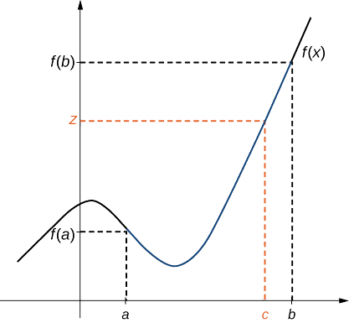
Figure 2.5.6: There is a number c ∈ [a,b] that satisfies f(c) = z.
Example 2.5.9: Application of the Intermediate Value Theorem
Show that f(x) = x − cosx has at least one zero.
Solution
Since f(x) = x − cosx is continuous over (−∞, +∞) , it is continuous over any closed interval of the form [a, b]. If you can find an interval [a, b] such that f(a) and f(b) have opposite signs, you can use the Intermediate Value Theorem to conclude there must be a real number c in (a, b) that satisfies f(c) = 0 . Note that
f(0) = 0 − cos(0) = −1 < 0
and
f( ^{π} ) = ^{π} − cos ^{π} = ^{π} > 0 .
2 2 2 2
Using the Intermediate Value Theorem, we can see that there must be a real number c in [0, π/2] that satisfies f(c) = 0 . Therefore, f(x) = x − cosx has at least one zero.
Example 2.5.10: When Can You Apply the Intermediate Value Theorem?
If f(x) is continuous over [0, 2], f(0) > 0 and f(2) > 0 , can we use the Intermediate Value Theorem to conclude that f(x) has no zeros in the interval [0, 2]? Explain.
Solution
No. The Intermediate Value Theorem only allows us to conclude that we can find a value between f(0) and f(2) ; it doesn’t allow us to conclude that we can’t find other values. To see this more clearly, consider the function f(x) = (x − 1)² . It satisfies f(0) = 1 > 0, f(2) = 1 > 0 , and f(1) = 0 .
Example 2.5.11: When Can You Apply the Intermediate Value Theorem?
For f(x) = 1/x, f(−1) = −1 < 0 and f(1) = 1 > 0 . Can we conclude that f(x) has a zero in the interval [−1, 1]?
Solution
No. The function is not continuous over [−1, 1]. The Intermediate Value Theorem does not apply here.
Exercise 2.5.5
Show that f(x) = x³ − x² − 3x + 1 has a zero over the interval [0, 1].
Hint
Find f(0) and f(1). Apply the Intermediate Value Theorem.
Answer
f(0) = 1 > 0, f(1) = −2 < 0; f(x) is continuous over [0, 1]. It must have a zero on this interval.
KEY CONCEPTS
For a function to be continuous at a point, it must be defined at that point, its limit must exist at the point, and the value of the function at that point must equal the value of the limit at that point.
Discontinuities may be classified as removable, jump, or infinite.

Slide 9
A function is continuous over an open interval if it is continuous at every point in the interval. It is continuous over a closed interval if it is continuous at every point in its interior and is continuous at its endpoints.
The composite function theorem states: If f(x) is continuous at L and lim_{x→a} g(x) = L , lim_{x→a} f(g(x)) = f(lim_{x→a} g(x)) = f(L) .
then
The Intermediate Value Theorem guarantees that if a function is continuous over a closed interval, then the function takes on every value between the values at its endpoints.
GLOSSARY
continuity at a point
A function f(x) is continuous at a point a if and only if the following three conditions are satisfied: (1) f(a) is defined, (2)
lim_{x→a} f(x) exists, and (3) limx → af(x) = f(a)
continuity from the left
A function is continuous from the left at b if lim_{x→b}⁻ f(x) = f(b)
continuity from the right
A function is continuous from the right at a if lim_{x→a}⁺ f(x) = f(a)
continuity over an interval
a function that can be traced with a pencil without lifting the pencil; a function is continuous over an open interval if it is continuous at every point in the interval; a function f(x) is continuous over a closed interval of the form [a, b] if it is continuous at every point in (a, b), and it is continuous from the right at a and from the left at b
discontinuity at a point
A function is discontinuous at a point or has a discontinuity at a point if it is not continuous at the point
infinite discontinuity
An infinite discontinuity occurs at a point a if lim_{x→a}⁻ f(x) = ±∞ or lim_{x→a}⁺ f(x) = ±∞
Intermediate Value Theorem
Let f be continuous over a closed bounded interval [a, b] if z is any real number between f(a) and f(b), then there is a number c in [a, b] satisfying f(c) = z
jump discontinuity
A jump discontinuity occurs at a point a if lim_{x→a}− f(x) and lim_{x→a}+ f(x) both exist, but lim_{x→a}− f(x) ≠ lim_{x→a}+ f(x)
removable discontinuity
A removable discontinuity occurs at a point a if f(x) is discontinuous at a, but lim_{x→a} f(x) exists
CONTRIBUTORS
Gilbert Strang (MIT) and Edwin “Jed” Herman (Harvey Mudd) with many contributing authors. This content by OpenStax is licensed with a CC-BY-SA-NC 4.0 license. Download for free at http://cnx.org.

